Slide 1


Slide 2
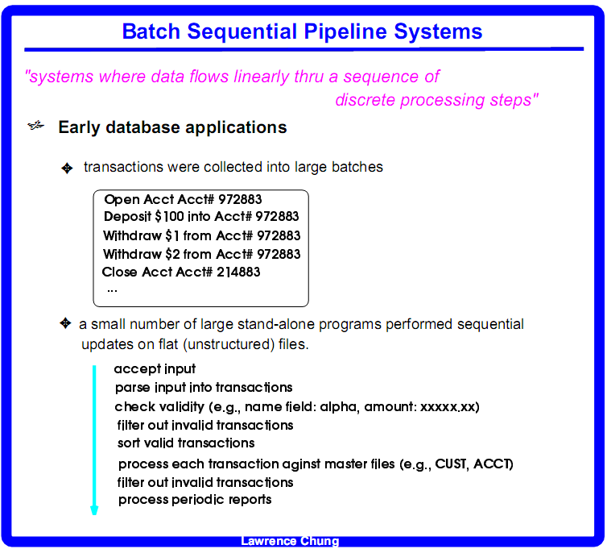

Slide 3
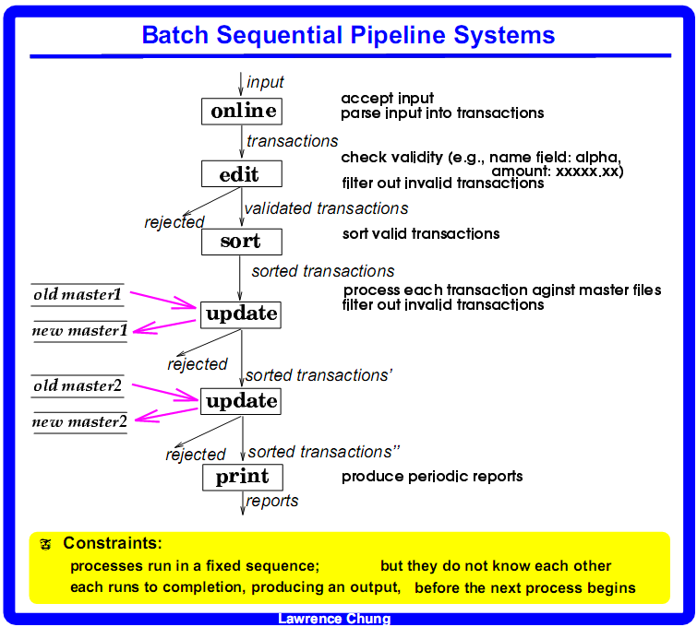

Slide 4
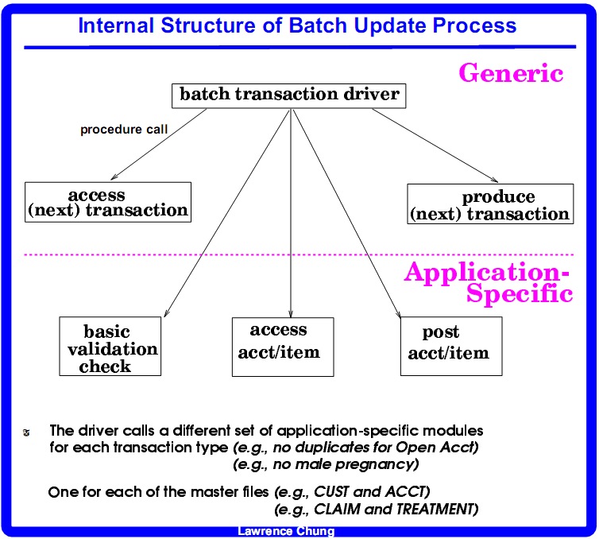

Slide 5


Slide 6
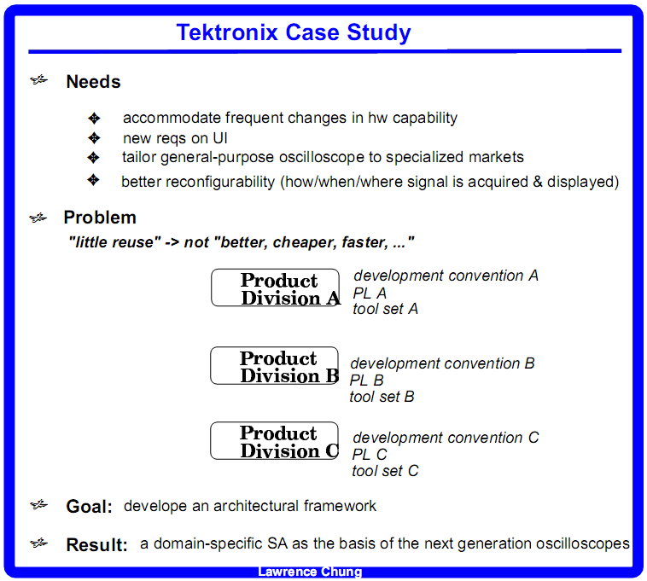

Slide 7
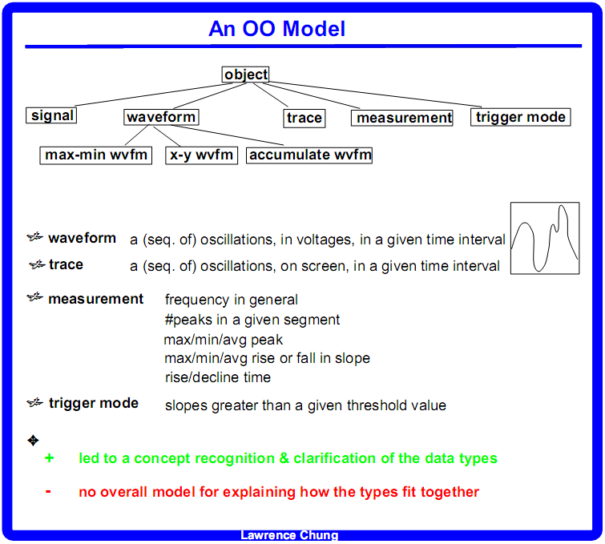

Slide 8
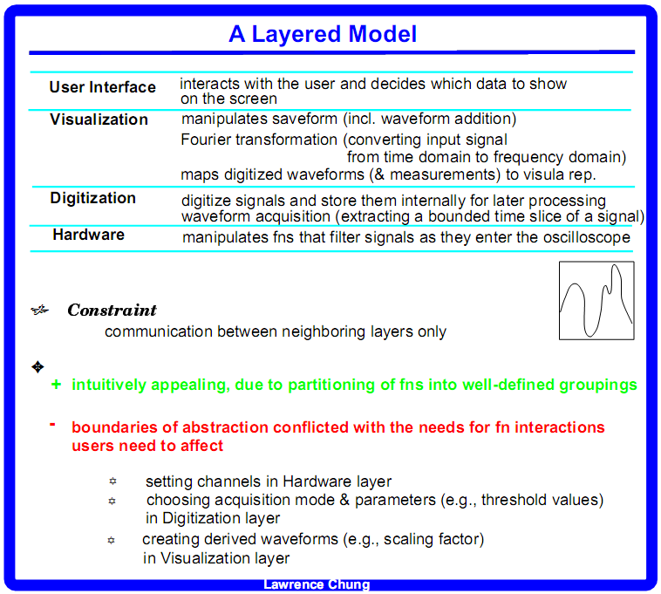
Hybrid
Pure
Performance degradation
harder to understand
harder to modify
harder to maintain
………

Slide 9
Method invocation has overhead
Method 1 invokes method 2
OS allocates MM(buffer space) to store the value of the variables in method 1
OS allocates enough MM(buffer space) for variables in method 2..
Execute method 2
Restore variables of method 1 and continue execution

Slide 10
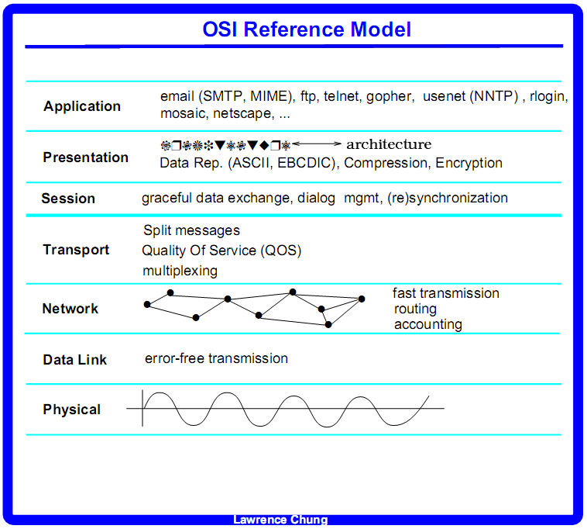

Slide 11
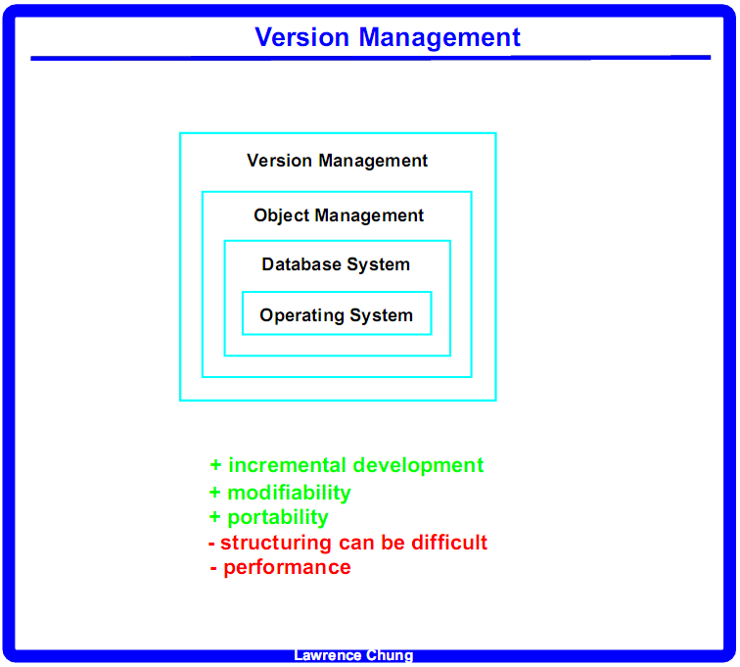
Database: DDL (schema) + DML
Person
Student
SSN
name
Units of manipulation
Std #
SSN
Person
name
School
Std #
Student

Slide 12
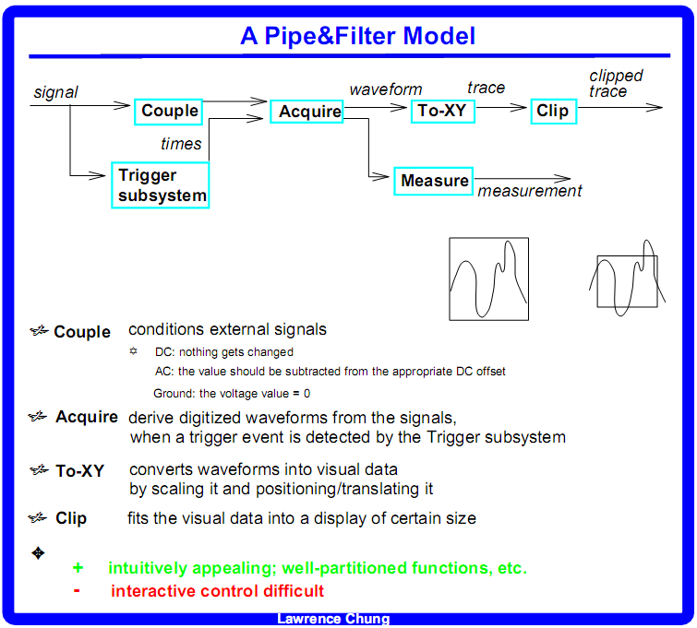

Slide 13
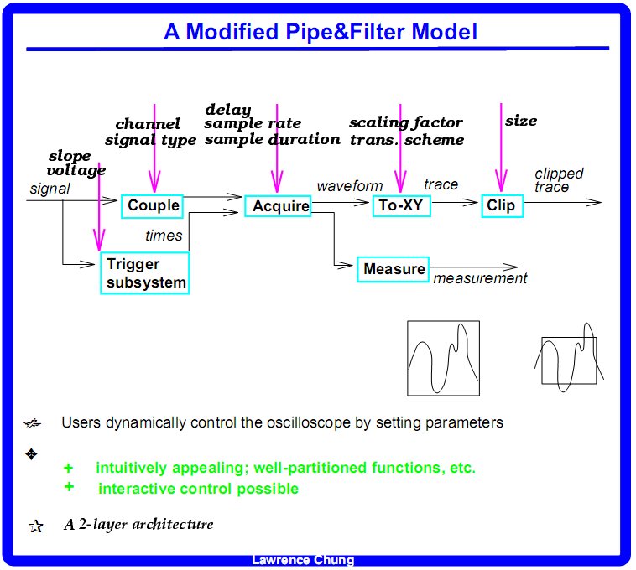

Slide 14


